Slide 1
Hierarchical and Density Based Clustering
By
B A Sabarish
Nalinadevi K

Slide 2
Hierarchical Clustering
Agglomerative Clustering

Slide 3
Introduction
Hierarchical clustering is another unsupervised machine learning algorithm, which is used to group the unlabeled datasets into a cluster and also known as hierarchical cluster analysis or HCA.
hierarchy of clusters in the form of a tree, and this tree-shaped structure is known as the dendrogram.
Why
A predetermined number of clusters,
It always tries to create the clusters of the same size.

Slide 4
Approaches
Agglomerative: Agglomerative is a bottom-up approach, in which the algorithm starts with taking all data points as single clusters and merging them until one cluster is left.
Divisive: Divisive algorithm is the reverse of the agglomerative algorithm as it is a top-down approach.

Slide 5
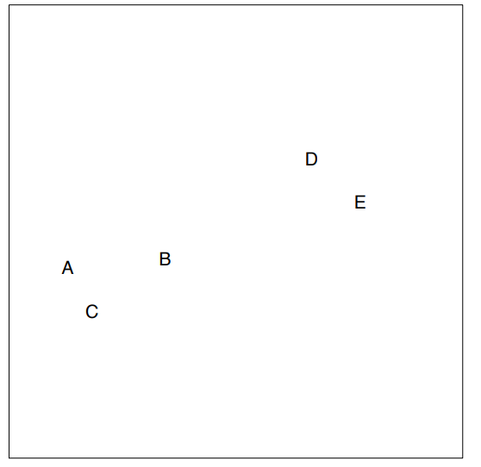
Agglomerative Hierarchical clustering
Step-1: Create each data point as a single cluster. Let's say there are N data points, so the number of clusters will also be N.

Slide 6
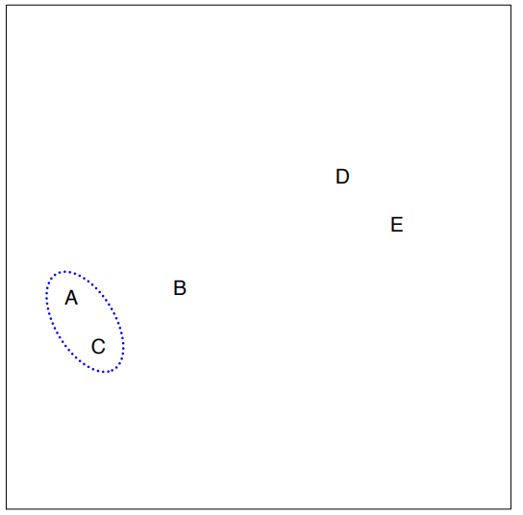
Agglomerative Hierarchical clustering
Step-2: Take two closest data points or clusters and merge them to form one cluster. So, there will now be N-1 clusters.

Slide 7
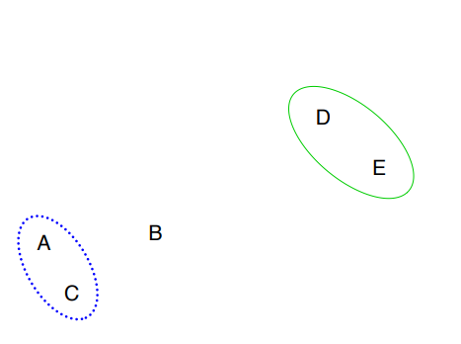
Agglomerative Hierarchical clustering
Step-3: Again, take the two closest clusters and merge them together to form one cluster. There will be N-2 clusters.

Slide 8
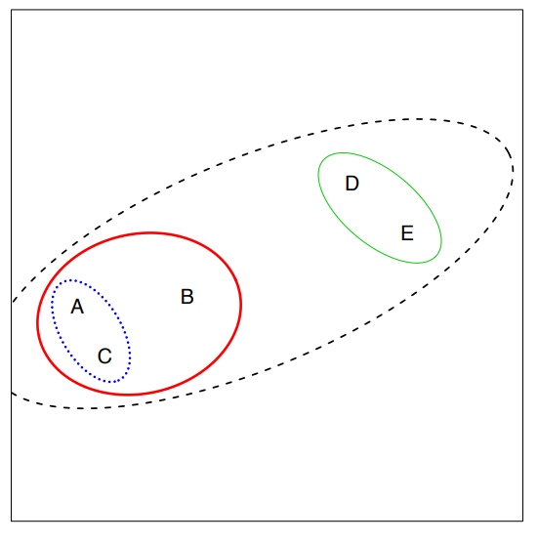
Agglomerative Hierarchical clustering
Step-4: Repeat Step 3 until only one cluster left. So, we will get the following clusters.

Slide 9
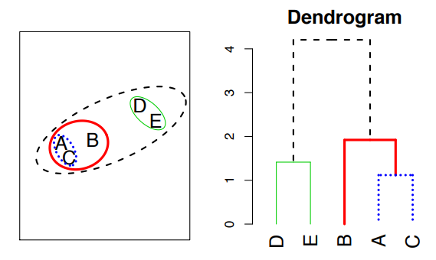
Result

Slide 10
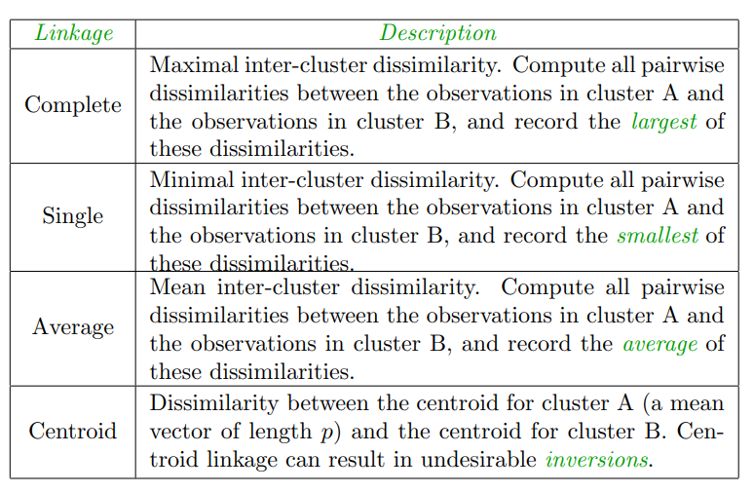
Linkage Measure/ Measure for the distance between two clusters

Slide 11
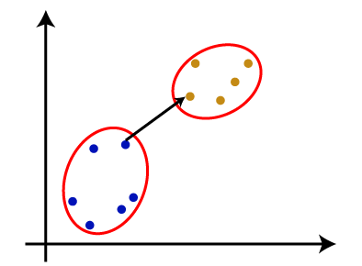
Single Linkage - Definition
It is the Shortest Distance between the closest points of the clusters.

Slide 12
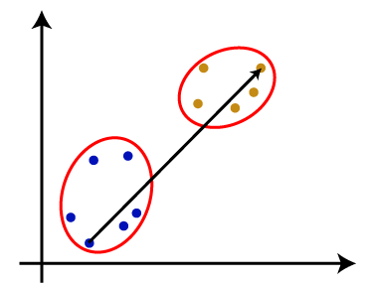
Complete Linkage - Definition
It is the farthest distance between the two points of two different clusters. It is one of the popular linkage methods as it forms tighter clusters than single-linkage.

Slide 13
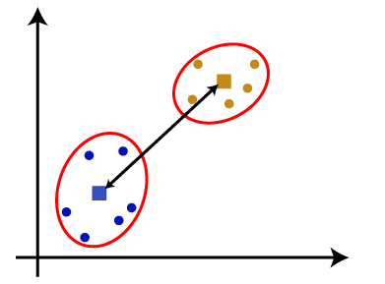
Average Linkage and Centroid Linkage - Definition
Average Linkage: It is the linkage method in which the distance between each pair of datasets is added up and then divided by the total number of datasets to calculate the average distance between two clusters. It is also one of the most popular linkage methods.
Centroid Linkage: It is the linkage method in which the distance between the centroid of the clusters is calculated. Consider the below image:

Slide 14
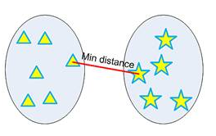
Single Linkage - Example
single linkage hierarchical clustering or nearest neighbor clustering
Distance between two clusters is defined by the minimum distance between objects of the two clusters

Slide 15
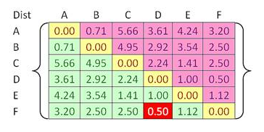
Single Linkage - Example

Slide 16
Single Linkage – Example- Step 1
Beginning with 6 clusters. Our goal is to group those 6 clusters such that at the end of the iterations, have only single cluster consists of the whole six original objects.
closest cluster is between cluster F and D with shortest distance of 0.5. Thus, we group cluster D and F into cluster (D, F).

Slide 17
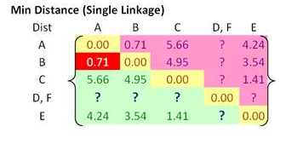
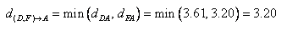
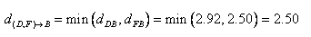
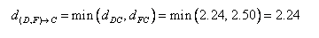
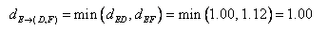
Single Linkage – Example – step 1
single linkage, minimum distance between original objects of the two clusters.
Using the input distance matrix, distance between cluster (D, F) and cluster A is computed as

Slide 18
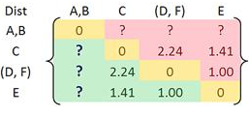
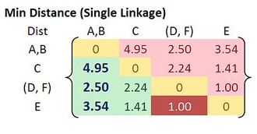
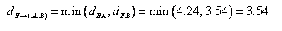
Single Linkage – Example – Step 2
Closest distance between cluster B and cluster A is now 0.71. Thus, we group cluster A and cluster B into a single cluster name (A, B).

Slide 19
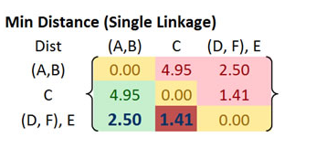
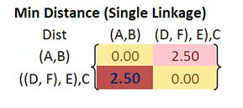
Single Linkage – Example – step 3 & 4

Slide 20
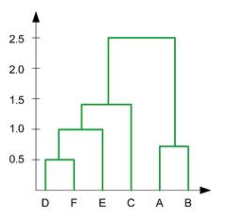
Single Linkage - Summary
In the beginning we have 6 clusters: A, B, C, D, E and F
Merge cluster D and F into cluster (D, F) at distance 0.50
Merge cluster A and cluster B into (A, B) at distance 0.71
Merge cluster E and (D, F) into ((D, F), E) at distance 1.00
Merge cluster ((D, F), E) and C into (((D, F), E), C) at distance 1.41
Merge cluster (((D, F), E), C) and (A, B) into ((((D, F), E), C), (A, B)) at distance 2.50

Slide 21
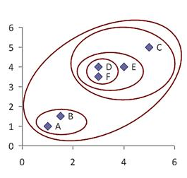
Single Linkage - Dendogram

Slide 22
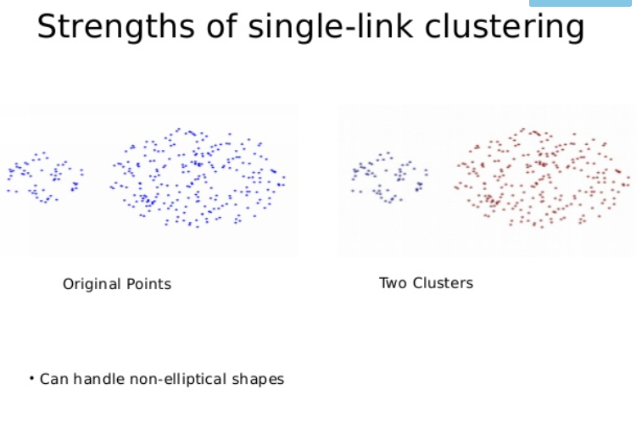

Slide 23
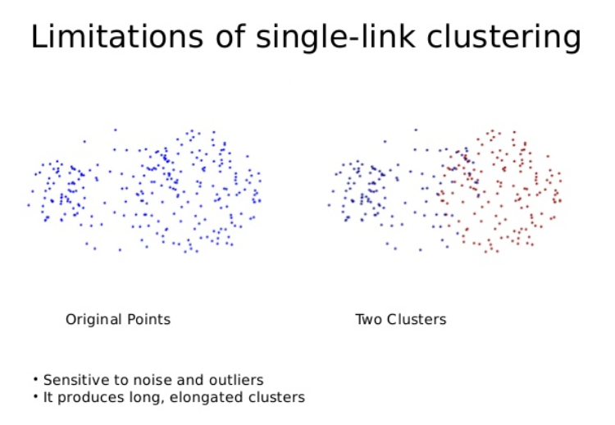

Slide 24
Complete Linkage – Example – Step 1
Beginning with 6 clusters. Our goal is to group those 6 clusters such that at the end of the iterations, have only single cluster consists of the whole six original objects.
closest cluster is between cluster F and D with shortest distance of 0.5. Thus, we group cluster D and F into cluster (D, F).

Slide 25
Complete Linkage – Example – Step 1
A B C D E F
complete linkage, maximum distance between original objects of the two clusters.
Using the input distance matrix, distance between cluster (D, F) and cluster A is computed as
d_{(D,F)→A} = max(d_{DA}, d_{FA}) = max(3.61, 3.20) =3.61
d_{(D,F)→B} = max(d_{DB}, d_{FB}) = max(2.92, 2.50) =2.92
d_{(D,F)→C} = max(d_{DC}, d_{FC}) = max(2.24, 2.50) =2.50
d_{(D,F)→E} = max(d_{DE}, d_{FE}) = max(1.00, 1.12) =1.12
A
B
C
D
E
F
0.00
0.71 | 0.00
5.66 | 4.95 | 0.00
3.61 | 2.92 | 2.24 | 0.00
4.54 | 3.54 | 1.41 | 1.00 | 0.00
3.20 | 2.50 | 2.50 | 0.50 | 1.12 | 0.00
A B C D,F E
A
B
C
D,F
E
0.00
0.71 | 0.00
5.66 | 4.95 | 0.00
3.61 | 2.92 | 2.5 | 0.00
4.54 | 3.54 | 1.41 | 1.12 | 0.00

Slide 26
Complete Linkage – Example – Step 2
Choose the minimum distance between A and B
Using the input distance matrix, distance between cluster (A,B) and cluster C is computed as
d_{(A,B)→C}= max(d_{AC}, d_{BC}) = max(5.66, 4.95) =5.66
d_{(A,B)→(D,F)}= max(d_{A(D,F)}, d_{B(D,F)}) = max(3.61, 2.92) =3.61
d_{(A,B)→E}= max(d_{AE}, d_{BE}) = max(4.54, 3.54) =4.54
A B C D,F E
A
B
C
D,F
E
0.00
0.71 | 0.00
5.66 | 4.95 | 0.00
3.61 | 2.92 | 2.5 | 0.00
4.54 | 3.54 | 1.41 | 1.12 | 0.00
A,B C D,F E
A,B
C
D,F
E
0.00
5.66 | 0.00
3.61 | 2.92 | 0.00
4.54 | 3.54 | 1.41 | 0.00

Slide 27
Complete Linkage – Example – Step 3
Choose the minimum distance between D,F and E
Using the input distance matrix, distance between cluster((D,F) ,E)and cluster (A,B) is computed as
d_{(D,F),E)->(A,B)} = max(d_{(D,F)->(A,B)}, d_{E->(A,B)}) = max(3.61, 4.54) =4.54
d _{(D,F),E)->C}= max(d_{(D,F)->C}, d_{E->C}) = max(2.92, 3.54) =3.54
A,B C D,F E
A,B
C
D,F
E
0.00
5.66 | 0.00
3.61 | 2.92 | 0.00
4.54 | 3.54 | 1.41 | 0.00
A,B C D,F,E
A,B
C
D,F,E
0.00
5.66 | 0.00
4.54 | 3.54 | 0.00

Slide 28
Complete Linkage – Example – Step 4
Choose the minimum distance between D,F,E and C
Using the input distance matrix, distance between cluster(((D,F) ,E),C) and cluster (A,B) is computed as
d_{((D,F),E),C)->(A,B)} = max(d_{((D,F),E)->(A,B)}, d_{C->(A,B)}) = max(4.54, 5.66) =5.66
A,B C D,F,E
A,B
C
D,F,E
0.00
5.66 | 0.00
4.54 | 3.54 | 0.00
A,B D,F,E,C
A,B
D,F,E,C
0.00
5.66 | 0.00

Slide 29
Complete Linkage - Summary
In the beginning we have 6 clusters: A, B, C, D, E and F
Merge cluster D and F into cluster (D, F) at distance 0.50
Merge cluster A and cluster B into (A, B) at distance 0.71
Merge cluster E and (D, F) into ((D, F), E) at distance 1.41
Merge cluster ((D, F), E) and C into (((D, F), E), C) at distance 3.54
Merge cluster (((D, F), E), C) and (A, B) into ((((D, F), E), C), (A, B)) at distance 5.66
Draw the dendrogram !!!!!

Slide 30
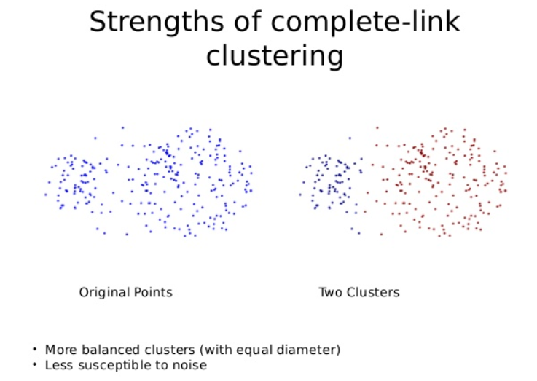

Slide 31
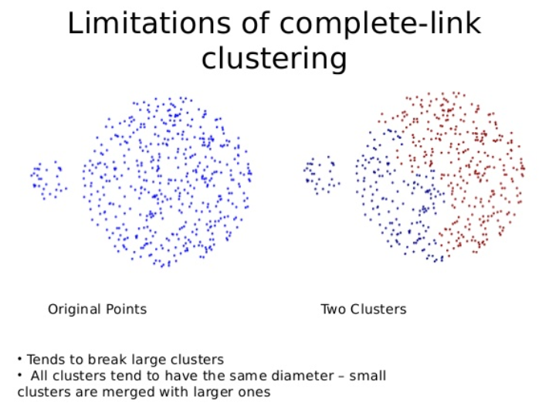

Slide 32
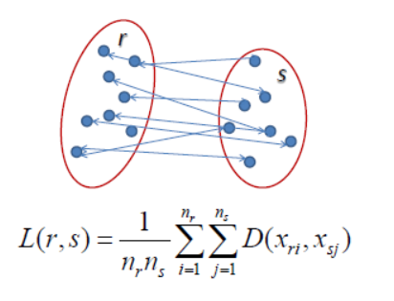
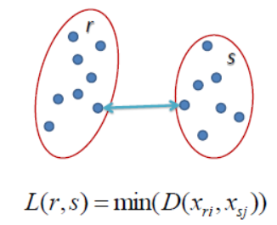
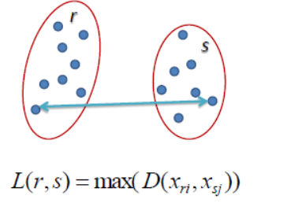
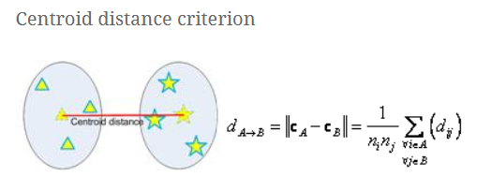
Single Linkage Complete Linkage Average Linkage
(Centroid Linkage)

Slide 33
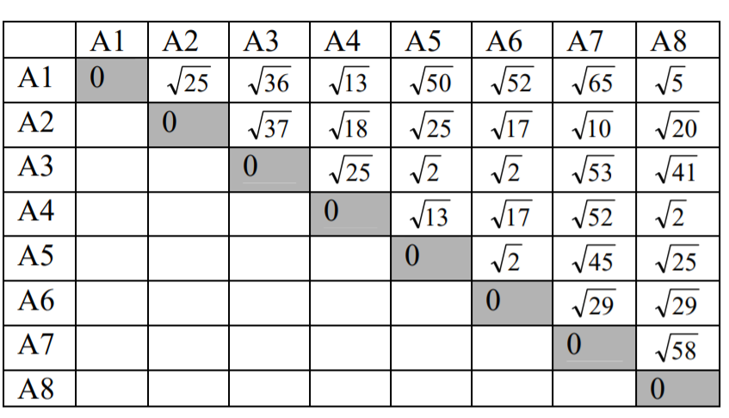
Try all the 4 linkage on this distance matrix !!!!!!

Slide 34
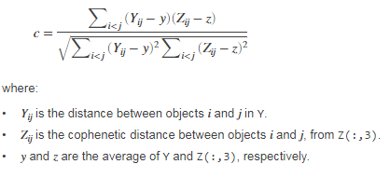
Performance Evaluation- Cophenetic correlation Coefficient
is a measure of how faithfully a dendrogram preserves the pairwise distances between the original un-modeled data points.

Slide 35
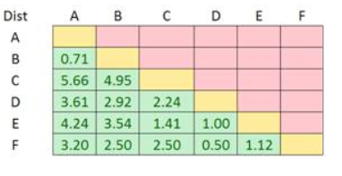
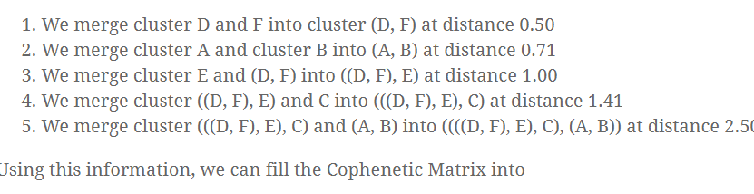
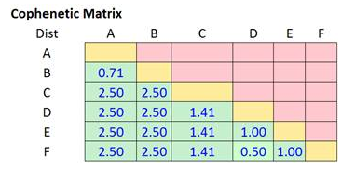
Performance Evaluation- Cophenetic Correlation Coefficient - Distance matrix to Cophenetic matrix

Slide 36
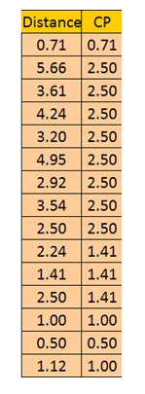
Performance Evaluation- Cophenetic Correlation coefficient - Cophenetic Matrix
C= 82.6%

Slide 37
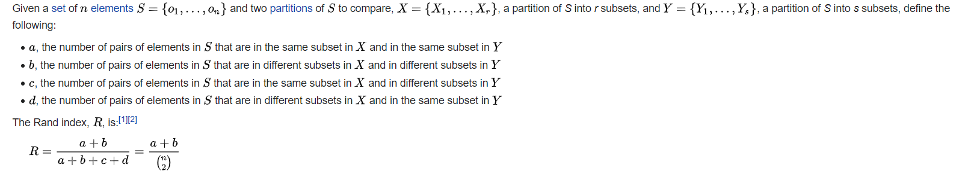
Performance Evaluation – Rand Index
The Rand index has a value between 0 and 1, with 0 indicating that the two data clusterings do not agree on any pair of points and 1 indicating that the data clusterings are exactly the same.

Slide 38
Performance Evaluation – Rand Index –Example
Say we have a set of six elements: {a, b, c, d, e, f}.
Clustering method 1 (CM1) forms three clusters; the first two items are in group 1, the third and fourth are in group 2, and the fifth and sixth are in group 3: {1, 1, 2, 2, 3, 3}.
Clustering method 2 (CM2) forms two clusters; the first three items are in group 1 and the last three items are in group 2: {1, 1, 1, 2, 2, 2}.
What’s the Rand index of these two clustering results?
a is the number of pairs of elements grouped same in CM1 and CM2 are {a,b} and {e,f} , hence a=2
b is the number of pairs of elements not grouped together in CM1 and CM2 are {a,d}, {a,e}, {a,f}, {b,d}, {b,e}, {b,f},{c,e}, {c,f}, hence b=8
Rand Index RI= a+b / (n*(n-1) /2) = (2* (2+8)) / (6 *5) = .667

Slide 39
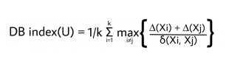
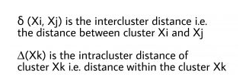
Performance Evaluation- Davies Bouldin Index
function of the ratio of the within cluster scatter, to the between cluster separation.
Lower the DB index value, better is the clustering.

Slide 40
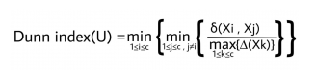
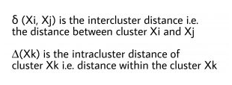
Performance Evaluation- Dunn Index
the aim is to identify sets of clusters that are compact, with a small variance between members of the cluster, and well separated, where the means of different clusters are sufficiently far apart, as compared to the within cluster variance.

Slide 41
Performance Evaluation- Silhouette
refers to a method of interpretation and validation of consistency within clusters of data.
silhouette ranges from −1 to +1, where a high value indicates that the object is well matched to its own cluster and poorly matched to neighboring clusters. If most objects have a high value, then the clustering configuration is appropriate.
1: Means clusters are well apart from each other and clearly distinguished.
0: Means clusters are indifferent, or we can say that the distance between clusters is not significant.
-1: Means clusters are assigned in the wrong way.

Slide 42
Performance Evaluation- Silhouette
Silhouette Score = (b-a)/max(a,b)
where
a= average intra-cluster distance (the average distance between each point within a cluster).
b= average inter-cluster distance ( the average distance between all clusters).

Slide 43
DBSCAN
Density-based spatial clustering of applications with noise

Slide 44
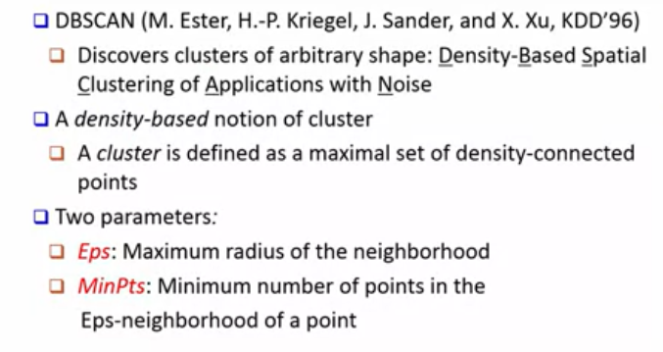
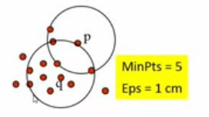
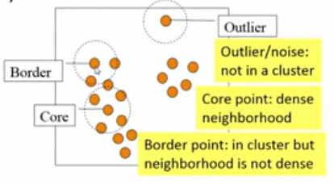
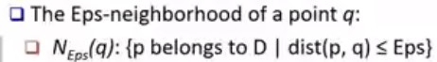
DBSCAN: Density-Based Clustering

Slide 45
DBSCAN : Density-Based Clustering
Characterization of points
A point is a core point if it has more than a specified number of points (MinPts) within Eps
These points belong to the dense region and are at the interior of a cluster
A border point has fewer than MinPts within Eps, but is in the neighborhood of a core point.
A noise point has fewer than MinPts within Eps, and is not in the neighborhood of a core point.

Slide 46
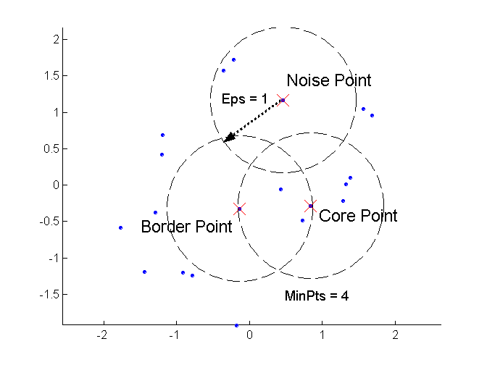
DBSCAN: Core, Border, and Noise Points

Slide 47
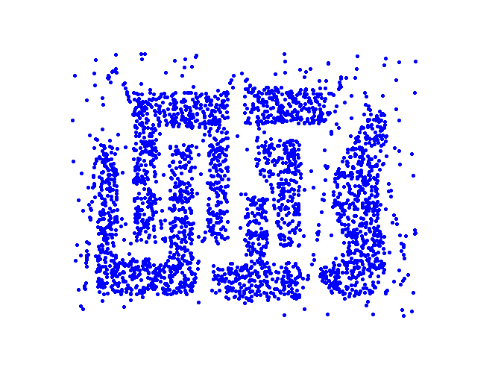
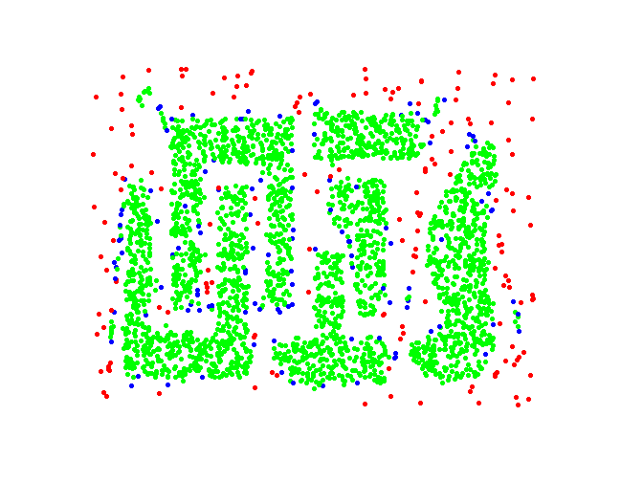
DBSCAN: Core, Border and Noise Points
Point types: core, border and noise
Original Points
Eps = 10, MinPts = 4

Slide 48
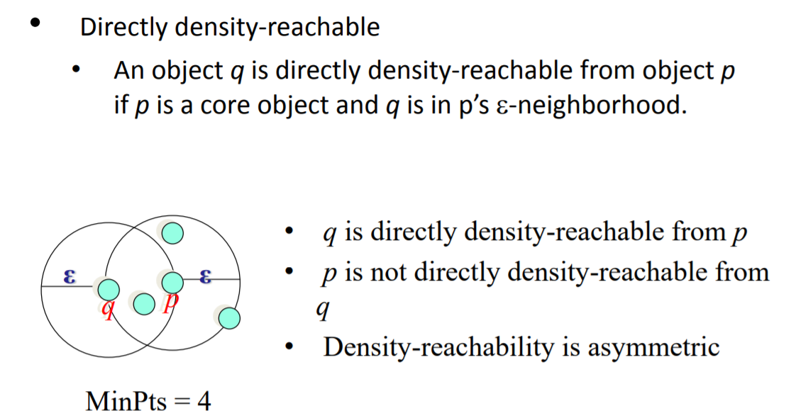
DBSCAN: Directly Density-Reachable
q <-p

Slide 49

DBSCAN : Directly Reachable

Slide 50
DBSCAN Algorithm
Label points as core, border and noise
Eliminate noise points
For every core point p that has not been assigned to a cluster
Create a new cluster with the point p and all the points that are density-connected to p.
Assign border points to the cluster of the closest core point.

Slide 51

DBSCAN – Algorithm and Complexity

Slide 52


How does DBSCAN Work?

Slide 53

DBSCAN: Working –first core point
Select an arbitrary point p as shown in red
If the number of neighbours of p >= Minpts then p is a core point

Slide 54


DBSCAN: working first Border point
Select the next arbitrary point p as shown in yellow
If the number of neighbours of p <= Minpts and has one core point neighbour then p is a border point

Slide 55

DBSCAN: Working Next Core point
Select an arbitrary point p as shown in red
If the number of neighbours of p >= Minpts then p is a core point

Slide 56

DBSCAN: Working Next Core point
Select an arbitrary point p as shown in red
If the number of neighbours of p >= Minpts then p is a core point

Slide 57

DBSCAN: Working first Outlier/noise point
Select an arbitrary point p as shown in Grey
If there are no neighbours of p then p is a outlier point

Slide 58

DBSCAN: Working Next Core point
Select an arbitrary point p as shown in red
If the number of neighbours of p >= Minpts then p is a core point

Slide 59

DBSCAN: Identifying Clusters using Density Reachability

Slide 60

DBSCAN: Example
If Epsilon is 2 and minpoint is 2, what are the clusters that DBScan would discover with the following 8 examples: A1=(2,10), A2=(2,5), A3=(8,4), A4=(5,8), A5=(7,5), A6=(6,4), A7=(1,2), A8=(4,9).
Distance Matrix
Epsilon Neighbour of Each point
N₂(A1)={};
N₂(A2)={};
N₂(A3)={A5, A6};
N₂(A4)={A8};
N₂(A5)={A3, A6};
N₂(A6)={A3, A5};
N₂(A7)={};
N₂(A8)={A4}

Slide 61

DBSCAN: Example
If Epsilon is 2 and minpoint is 2, what are the clusters that DBSCAN would discover with the following 8 examples: A1=(2,10), A2=(2,5), A3=(8,4), A4=(5,8), A5=(7,5), A6=(6,4), A7=(1,2), A8=(4,9).
Outlier Points: {A1, A2, A7}
Core Points: {A3, A4, A5, A6, A8}
Density Reachability between core points:
A3-> A5-> A6 hence they form cluster C1
A4 -> A8 hence they form the cluster C2
C1: {A3,A5,A6} C2: {A4, A8}
Epsilon Neighbour of Each point
N₂(A1)={};
N₂(A2)={};
N₂(A3)={A5, A6};
N₂(A4)={A8};
N₂(A5)={A3, A6};
N₂(A6)={A3, A5};
N₂(A7)={};
N₂(A8)={A4}
How many cluster will you get when Epsilon is $\sqrt{10}$?

Slide 62

DBSCAN is sensitive to setting of parameters

Slide 63

DBSCAN: Determining Eps and MinPts
Idea is that for points in a cluster, their k^{th} nearest neighbors are at roughly the same distance
Noise points have the k^{th} nearest neighbor at farther distance
So, plot sorted distance of every point to its k^{th} nearest neighbor
Find the distance d where there is a “knee” in the curve
Eps = d, MinPts = k
Eps ~ 7-10
MinPts = 4

Slide 64

When DBSCAN Works Well
Original Points
Clusters
Resistant to Noise
Can handle clusters of different shapes and sizes

Slide 65



When DBSCAN Does NOT Work Well
(MinPts=4, Eps=9.75).
Original Points
Varying densities
High-dimensional data
(MinPts=4, Eps=9.92)

Slide 66

K-Means vs DBSCAN

